Slide 1
Overview of Water/Wastewater Asset Manager (WAM™) Database

Slide 2
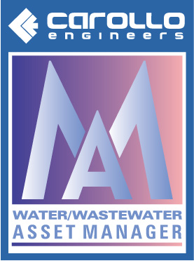
Water/Wastewater Asset Manager (WAMTM) Will Assist Your Management of…
Asset Management Process
Phase 1
Phase 2
Phase 3
Phase 4
Asset Valuation& R&R Develop.
Financial & Strategic Decision Analysis
Strategic Vision
Asset Inventory
Condition Assessments
O&M/CIP Integration
Implementation
Risks/Costs

Slide 3
Overview of WAM™ Database and Risk Model
Simple, easy to use, yet powerful software application
Features
Asset inventory and classification
Asset assessment data
Multiple valuations
Discipline categories including buried infrastructure
User customized graphs
Variety of reports, including prioritized filter reports
Digital photos
Time series

Slide 4
Run to Failure (Pump Example)
8
6
4
2
0
1
2
3
4
5
Rehab Cost
Capital Replacement Cost
COST ($)
CONDITION
0 1 2 3 4 5 6 7 8 9 10
YEARS IN SERVICE
Notes:
Another potential management decision that can be made based on a LCCA is whether to run an asset to failure or not. Again, by understanding the financial implications of the decisions ahead of time, the agency is able to make better, more informed decisions and determine the right timing. In this graph, the left hand y axis is condition, again from 5 to 1 and the right hand y axis is cost in dollars. The x axis is number of years in service. This LCCA shows that at year 5, the pump has been run to failure as noted by the fact that the curve goes to condition 5. The capital replacement cost is $8. At 8 years, the pump is rehabilitated at a cost of $1, so after 8 years the total LCCA is $9.

Slide 5
Just-in-Time Rehab.
8
6
4
2
0
1
2
3
4
5
Rehab Cost
Rehab Cost
CONDITION
COST ($)
0 1 2 3 4 5 6 7 8 9 10
YEARS IN SERVICE
Notes:
In comparison, this graph is again set up the same as the previous one. Here the LCCA shows that rehabilitation work has been done at year 4 for $2 and again at year 8 for $2 with a total cost of $4 after 8 years. By optimizing capital/rehabilitation decisions by choosing to rehab twice at the “right” times, there is a total cost savings shown by the LCCA of $5 in this example. Not only is the rehabilitation cost for this pump less, but the maintenance effort is also reduced as the pump is not rapidly declining in condition from year 4 to 5. Again, by doing a LCCA and thereby knowing the financial impacts of the potential decisions allows an agency to make the most cost effective decisions at the right time.

Slide 6
Asset Condition Table
Condition Description Ranking
Very Good 1 (0% maintenance required)
Minor Defects 2 (5% maintenance required)
Moderate Maintenance Required 3 (10-20% maintenance required)
Requires Renewal 4 (20-40% maintenance required)
Unserviceable 5 (>50% maintenance required)

Slide 7
WAMTM Financial Valuations
Financial valuation methods
Straight-line approach
Modified approach (GASB 34)
Financial valuation of assets
Acquisition cost
Evaluated value
Current value
Book value
Salvage value
Determine associated financial risk
Annual depreciation
Cumulative depreciation
Replacement costs
Repair costs
Maintenance costs

Slide 8
Case Studies

Slide 9
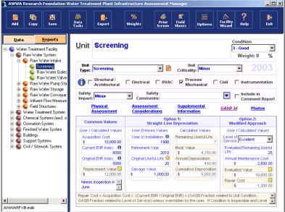
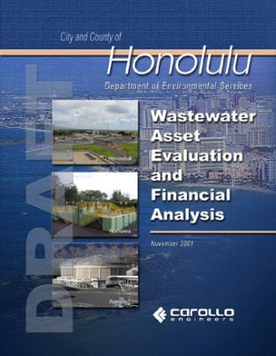
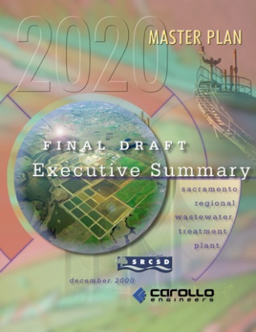
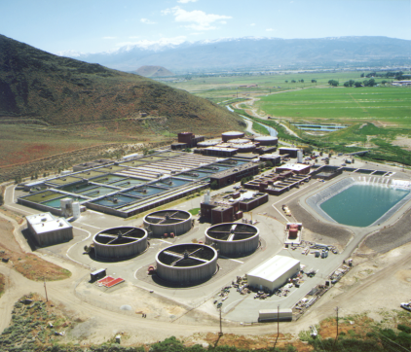
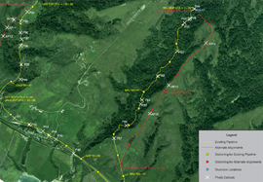
Carollo Asset Management Case Studies
Scottsdale AZ Asset Management Program
Zone 7 Water Agency CA Asset Management Program
Stockton CA Independent Asset Evaluator Services
Honolulu HI Asset Management Study
Sunnyvale CA WPCP Asset Condition Assessment
Union Sanitary District CA Asset Condition & R&R Assessment
Reno/Sparks/Washoe County NV Regional Water/Wastewater Program
CSU Mesa WTP Condition Assessment and Master Planning

Slide 10
Project Example: City of Scottsdale Asset Management Program
Background & Challenges:
New system relative to most of U.S.
No centralized asset database
True asset valuation for W/WW system
Ensure adequate funding for future R&R
Carollo tasked to implement comprehensive Asset Management Program:
Complete full asset inventories, condition assessments, & valuations
Prioritize assets based on risk
Develop centralized asset database
Determine long-term CIP for asset renewals

Slide 11
Project Example: City of Scottsdale Asset Management Program
8 treatment plants
87 lift/pump stations
56 wells + tanks
1,900 miles of distribution
1,200 miles of collection
Valuations & CIP planning for $4.5 billion of assets
Asset management databases
WAM (Above-Ground)
BAM (Below-Ground)

Slide 12
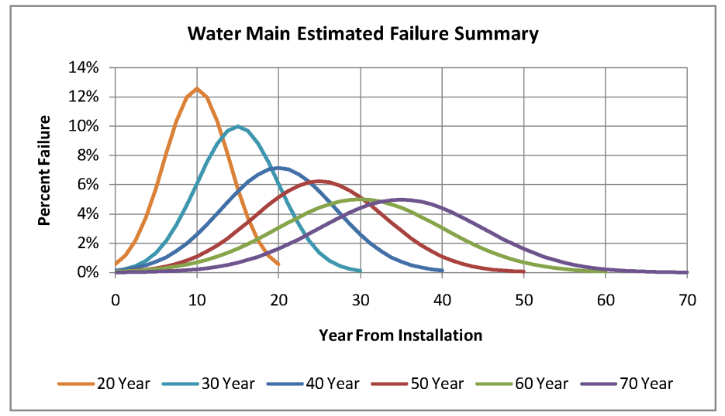
Below-Ground Asset Manager (BAMTM)
Simple, easy to use, yet powerful software application with GIS integration
Utilizes identical WAM calculation engine
Graphical risk, valuation and R&R analysis via MS Excel
Notes:
Included in the risk assessment is WAM – Carollo’s risk assessment software – which can be used to prioritize future R&R projects for inclusion in your CIP. This list is based on the assets condition, criticality, vulnerability, evaluated remaining physical and economic useful life. WAM is a tool which incorporates all aspects of the AMP – asset inventory, the condition assessment, optimization of R&R timing, financial valuations, etc. WAM can even be used to develop customized condition depreciation curves for your assets which can be used in determining upcoming maintenance and repair needs.

Slide 13
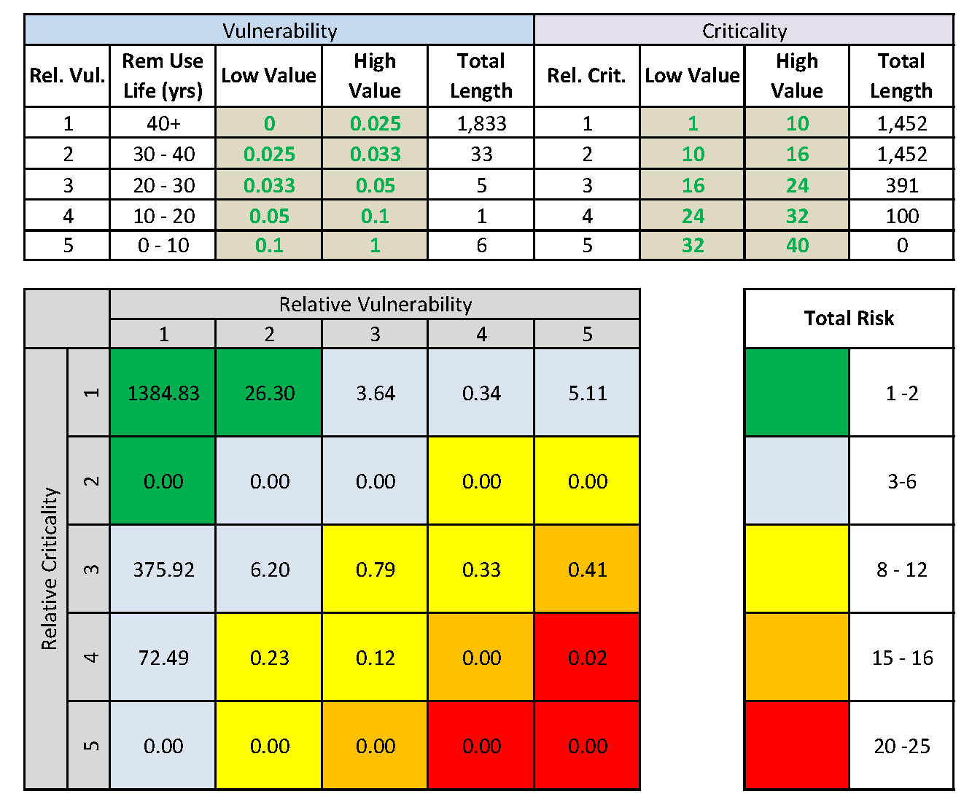

Slide 14
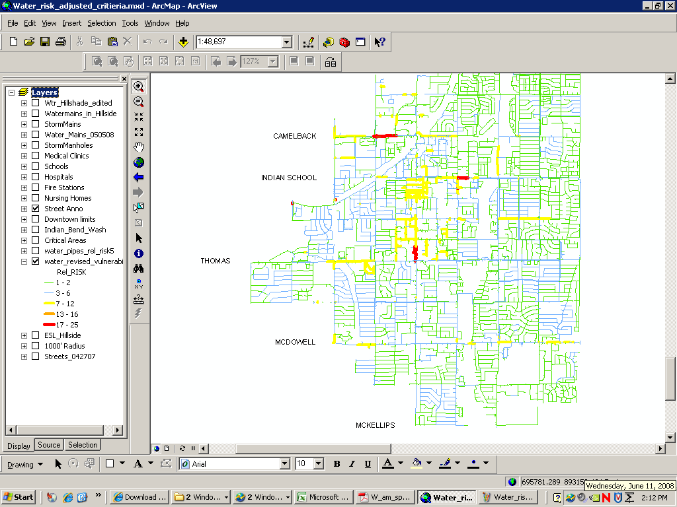

Slide 15
